Slide 1
The Dissemination of Culture A Model with Local Convergence and Global Polarization
Author: Robert Axelrod
Presenter: David Waters
CAP 6675 – Complex Adaptive Systems
University of Central Florida
Fall 2017

Slide 2
The Fundamental Principle of Human Communication
“The transfer of ideas occurs most frequently between individuals…who are similar in certain attributes such as beliefs, education, social status, and the like.” [2]
Similarity
Interaction

Slide 3
Goal
Present a model for social interaction which explains:
“How people influence each other on a given set of features” [1]
“Why this influence does not load to homogeneity” [1]
Explore
The Emergence of Cultural Regions
The Number of Stable Regions
Scope of Cultural Possibilities
Range of Interaction
Territory Size

Slide 4
Motivation
The study of cultural interactions presents an opportunity to examine
State Formation
How do people come together to form a society?
Succession
How does an existing society become divided into distinct factions?
Transnational Integration
How do nations interact with one another on a global scale?
Domestic Cleavages
Are existing divisions strengthened or weakened through interactions?

Slide 5
Terminology
Culture
“The set of individual attributes that are subject to social influence.” [1]
Represented in the model as a list of features
Example: [Language, Religion, Education, Manner of Dress, Political Preference]
Trait
The specific values that a feature may have
Example Traits for Language: {English, Spanish, Chinese, Hindi, Arabic}
Site
The model’s representation of one individual within a society
Cultural Region
“A set of contiguous sites with an identical culture.” [1]

Slide 6

Method
The Territory
An N x N matrix
Each cell is referred to as a Site
Each Site has Features/Traits
Neighbors: North, South, East, West
Eventually expanded neighborhoods are also tested
The Algorithm
[1]

Slide 7
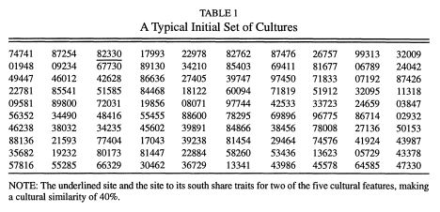
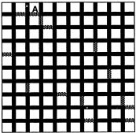
Interaction Example
Active Site (A) | 82330
Neighbor (South) | 67730
Common Traits | 3,0
Similarity | 2/5 Traits = 40%
[1]
During one interaction, there is a 40% chance that Active Site A will adopt a new trait from its Neighbor
Possible Outcomes
No Change
8 becomes 6
2 becomes 7
3 becomes 7
[1]

Slide 8
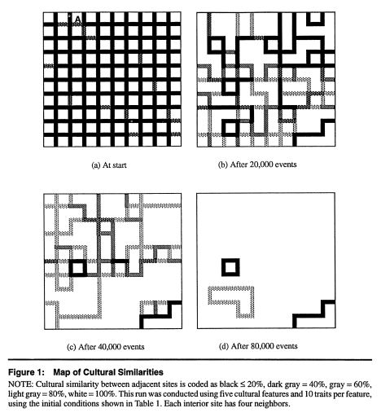
Results Emergence of Stable Regions
After 81,000 simulated interactions, the sites have resolved into Stable Regions
Stable Regions share no common traits with any of their neighbors
No further interaction is possible
Therefore no change will occur
The results can now be analyzed
[1]

Slide 9
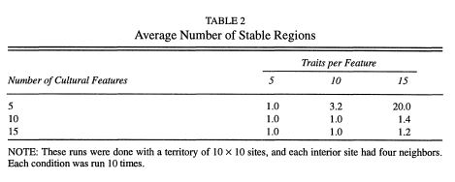
Results Number of Stable Regions
How does the number of Features or Traits relate to the number of Stable Regions produced?
More Features → Convergence
Greater chance that neighbors will be similar
More Traits → More Stable Regions
Greater chance that neighbors will be completely different and unable to interact
[1]
Base Experiment
Territory Size | 10 x 10
Features per Site | 5
Traits per Feature | 10
Result | 3.2 Stable Regions

Slide 10
Results Role of Neighborhood Size
Neighborhood Size | Pattern | Average Stable Cultural Regions
4 | North, South, East, West | 3.4
8 | N, S, E, W, + Diagonals | 2.5
12 | Diamond | 1.5
Larger Neighborhood → Higher chance of similarity
Greater Similarity → Less Stable Cultural Regions

Slide 11
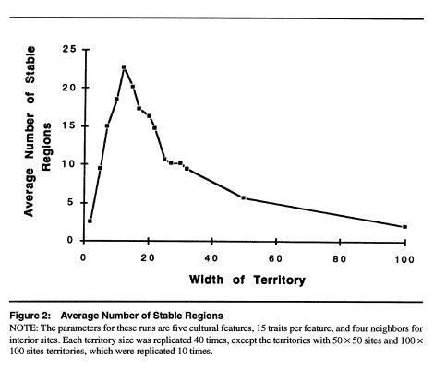
Results Size of the Territory
How is social interaction affected by territory size?
Small Territory
Few Stable Regions
Not enough sites to preserve different cultures
Large Territory
Few Stable Regions
Process takes longer
More interactions → more chances to increase similarity
[1]

Slide 12
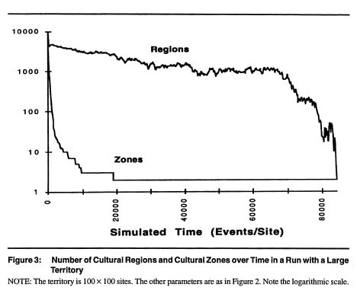
Results Cultural Zones
Cultural Zones
“A set of contiguous sites, each of which has a neighbor with a ‘compatible’ culture”[1]
“At least one feature in common” [1]
“The number of zones provides an early indication of just how many stable regions there will be.” [1]
“Most of the history of the run was spent with many compatible cultures ‘struggling for survival’…until only a single culture survived in each zone.” [1]
[1]

Slide 13
Strengths of the Article Accessibility
All aspects of the article are presented in simple language
Basic terms like trait and feature
Almost anyone could read and understand the paper
Not exclusive to individuals with a particular knowledge base
Statistics, Calculus, Physics, Ancient Egyptian Algebra…

Slide 14
Strengths of the Article Valuable Applications
Social interaction is fundamental
Applies in some way to everyone
Greater understanding has the potential to provide insight on everything from international relations to fashion trends
More informed decisions will likely yield more desirable outcomes

Slide 15
Strengths of the Article Abstraction
Easily extendable due to the simplicity of the individual elements
Just three components
Traits
Features
Sites
Allows for further development & exploration using the existing base
Just change the associated values based on what you want to simulate

Slide 16
Potential Improvements Support for Remote Communication
The model only considers communication between physical neighbors
In the real world, we have the ability to communicate globally
Telephone, Email, List a third thing here
Select active and neighbor sites without consideration of physical relation
This would simulate individuals communication electronically

Slide 17
Potential Improvements Allow Simultaneous Interactions
In the current model, each interaction between two sites occurs within it’s own discreet time tick
This is not a very accurate representation of actual human interaction
Realistically, one individual may interact with multiple neighbors at the same time
Additionally, such “mass” interactions may occur between the previously discussed geographically separated populations

Slide 18
Potential Improvements Consideration of Fads & Counterculture
The current model only allows for traits to be transmitted one at a time
Alternative: allow multiple traits to be transferred within a single interaction
This would simulate a more realistic correlation between traits
For example, Religion and Manner of Dress may be related and as such adopted together
Occasionally, members of a population will voluntarily adopt traits which conflict with the prevailing norm
This could be represented by the spontaneous emergence of sites which present a majority of traits that differ from their neighbors
Consideration of such spontaneous behavior would be more in line with real world behaviors

Slide 19
Potential Extensions Cultural Drift
Cultural Drift
The transmission of traits between neighbors who previously shared nothing in common with one another
Would not occur within the current model
Because Interaction only occurs between sites bearing some degree of similarity

Slide 20
Potential Extensions Cultural Drift
Incorporation to existing model
In instances of completely differing neighbors, calculate a random probability that a trait transmission would still occur
Consideration: When to stop?
Normally, the model would conclude when stable states have emerged and no further interaction/change is possible
If we allow for trait passing despite complete cultural difference, then the model would never stop, because there would always exist some potential for interaction and trait transmission
Solutions: Set a fixed ending point or watch for “general” stability

Slide 21
Potential Extensions Cultural Drift
Present more accurate model of social interaction
Realistically, traits are not restricted to individual cultures
Giving the sites some amount of “free will” to defy expected behavior
As humans sometimes do =)

Slide 22
Potential Extensions Variable Probabilistic Values
At the heart of each successful interaction, probability is a factor
The current model calculates the chances of successful transmission based on the ratio of common to differing traits
Rather than relying solely on the relative similarity of the sites, we could assign weighted values to some traits and/or sites

Slide 23
Potential Extensions Variable Probabilistic Values
Implementation
Adjust the probabilistic value
Traits
Sites
Both
Weight Adjustment
Positive or Negative
Depending on the focus of the experiment being conducted

Slide 24
Potential Extensions Variable Probabilistic Values
Higher Value Traits
More desirable or beneficial within the society
Example: Education could be considered more valuable than Manner of Dress
Higher Value Sites
Some individuals are more likely to contribute traits to others
Example: Celebrities, Members of a Higher Class, Societal Leaders (Political, Spiritual)

Slide 25
Potential Extensions Variable Probabilistic Values
Provide a more comprehensive analysis
More variables → Higher specialization of the study
Reflect a more realistic view of cultural interactions

Slide 26
References
1. Axelrod, R. April 1997. The Dissemination of Culture. Journal of Conflict Resolution, Issue 41, No. 2, 203 – 226.
2. Rogers, E. M. 1983. Diffusion of innovations. 3rd ed. New York: Free Press.

Slide 27
Questions?

